Slide 1


Lesson: 01
History of UNIX and Linux
azaj.ikbal

Slide 2
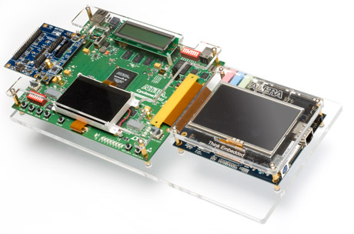
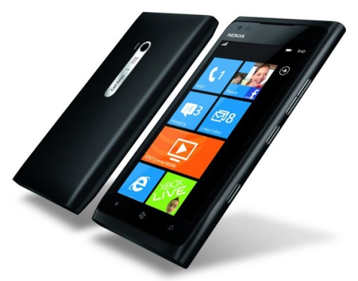
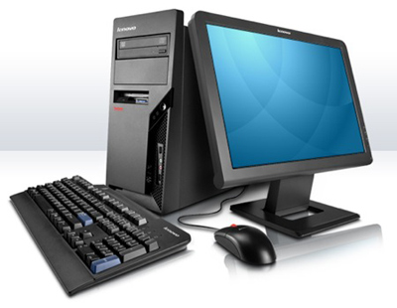
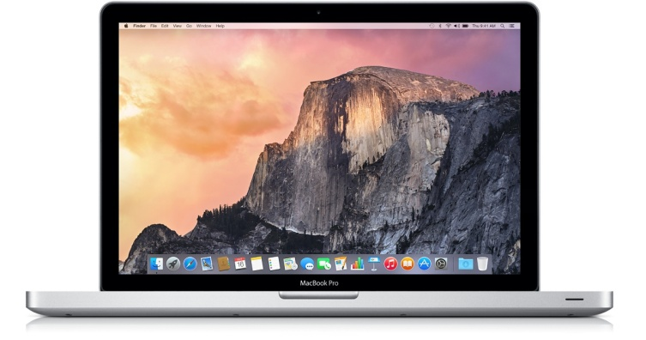
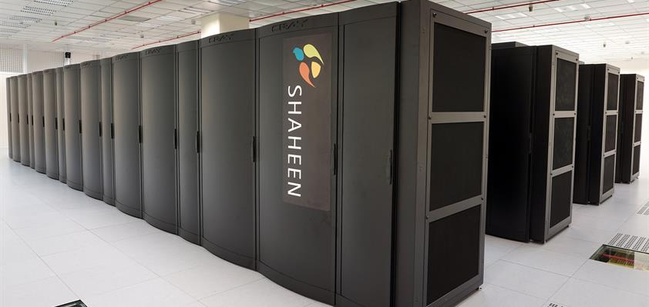
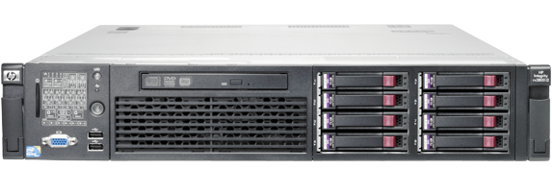
Computer Hardware Concepts
Embedded System
Smart Phone
Workstation
Laptop/MAC
Server
Supercomputer

Slide 3
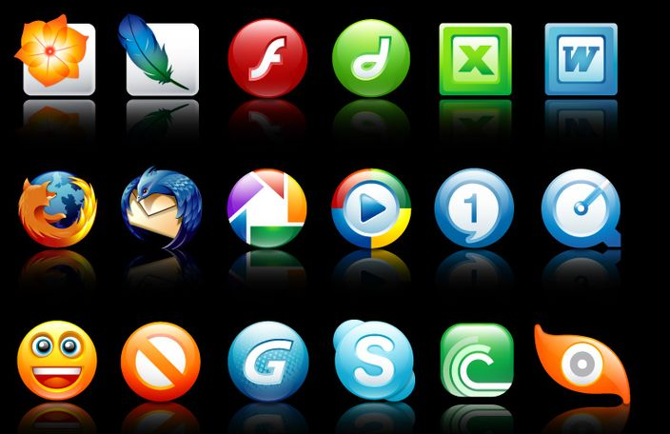
Application Software Concepts

Slide 4
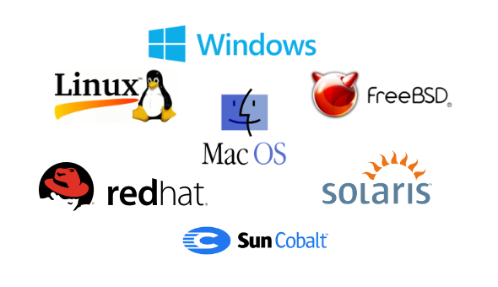
Operating System (OS) Concepts

Slide 5
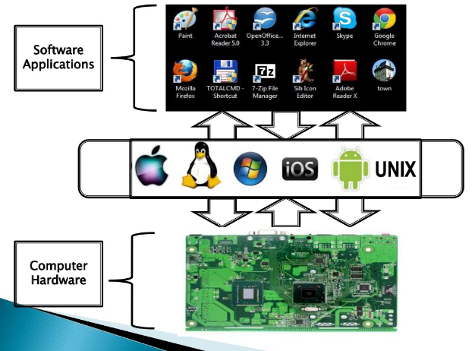
Parts of Operating System

Slide 6
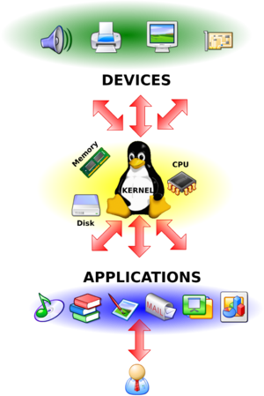
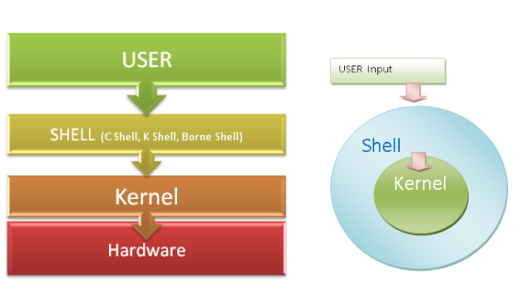
Parts of Operating System

Slide 7
Parts of Operating System
Linux System Architecture is consists of following layers
Hardware layer - Hardware consists of all peripheral devices (RAM/ HDD/ CPU etc).
Kernel - Core component of Operating System, interacts directly with hardware, provides low level services to upper layer components.
Shell - An interface to kernel, hiding complexity of kernel's functions from users. Takes commands from user and executes kernel's functions.
Utilities - Utility programs giving user most of the functionalities of an operating systems.

Slide 8
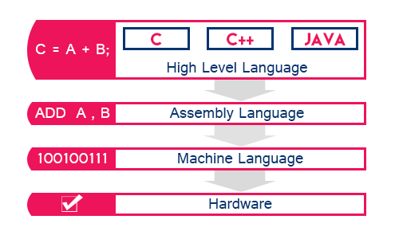
Computer Language

Slide 9
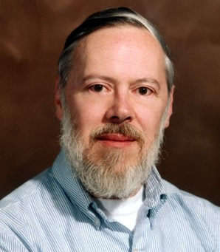
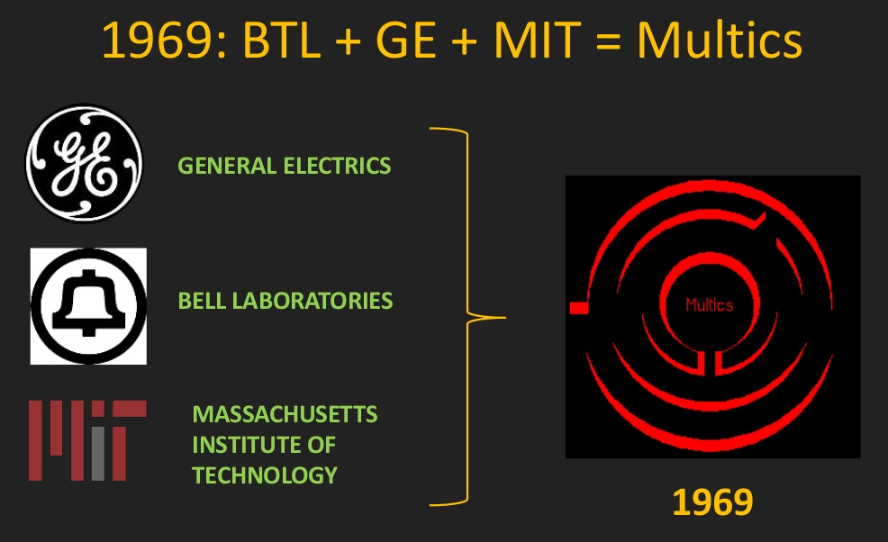
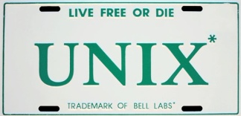
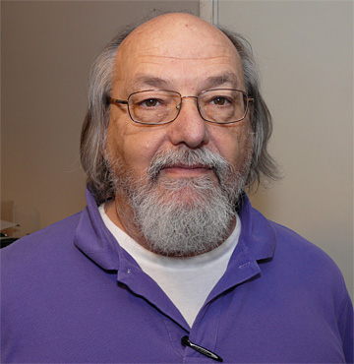
History of UNIX
Dennis Ritchie
The history of UNIX starts back in 1969, when Ken Thompson, Dennis Ritchie and others started working on the "little-used PDP-7 in a corner" at AT&T’s Bell Labs and what was to become UNIX.
Ken Thompson

Slide 10
History of UNIX
Year | History
1971 | First Edition
1972 | Second edition of UNIX released December 06, 1972.
1972 | Ritchie rewrote B and called the new language C.
1973 | Third edition (based on C) of UNIX released February 1973
1974 | It was rewritten in C. Forth edition of UNIX released November 1973
1975 | Fifth edition of UNIX released June 1974
1976 | Sixth edition of UNIX released May 1975
1976 | Bourne shell is introduced begins being added onto.
1979 | Seventh edition of UNIX released 1979

Slide 11
History of UNIX
Seventh Edition UNIX (1979)
System-V (1983)
BSD (1980)
Solaris (SUN)
AIX (IBM)
IRIX (SGI)
HP-UX (HP)
Digital UNIX (DEC)
SCO UNIX (SCO)
SUN OS 4.0 (SUN)
ULTRA IX (DEC)
FreeBSD (Open Source)
NetBSD (Open Source)
OpenBSD (Open Source)

Slide 12
More History About UNIX
Year | History
1985 | Eighth edition of UNIX released February 1985
1986 | HP-UX 1.0 released.
1986 | Ninth edition of UNIX released September 1986
1987 | Sun and AT&T lay the groundwork for business computing
1987 | UNIX clone operating system MINIX by Andrew Tanenbaum
1989 | Tenth edition of UNIX released October 1989
1990 | AIX was first entered into the market by IBM February 1990.

Slide 13

GNU Project and Free Software Foundation
Richard Stallman
In 1983 Richard Stallman's Free Software Foundation (FSF) began the GNU project, a project to create a free version of the Unix operating system. By free, Stallman meant software that could be freely used, read, modified, and redistributed. The FSF successfully built a vast number of useful components, including a C compiler (gcc), an impressive text editor (emacs), and a host of fundamental tools. However, in the 1990's the FSF was having trouble developing the operating system kernel; without a kernel their dream of a completely free operating system would not be realized.

Slide 14
GNU Project
Year | History
1983 | The GNU project is first announced by Richard Stallman.
Nobody should be restricted by the software they use. There are four freedoms that every user should have:
The freedom to run the program, for any purpose.
The freedom to study how the program works, and change it as your needs
The freedom to redistribute copies so you can help your neighbor.
The freedom to distribute copies of your modified versions to others.
www.gnu.org

Slide 15

Linus Torvalds and Linux
Linus Torvalds
In 1991 Linus Torvalds began developing an operating system kernel, which he named ``Linux''. This kernel could be combined with the FSF material and other components (in particular some of the BSD components and MIT's X-windows software) to produce a freely-modifiable and very useful operating system. This book will term the kernel itself the ``Linux kernel'' and an entire combination as ``Linux''. Note that many use the term ``GNU/Linux'' instead for this combination.

Slide 16
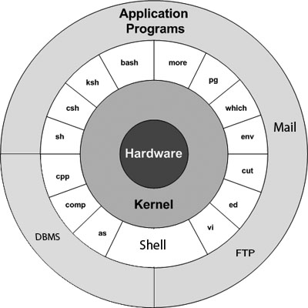
Part of Linux Operating System

Slide 17
More History About Linux OS
Year | History
1994 | Red Hat Linux is introduced.
1994 | Caldera, Inc was founded in 1994 by Ransom Love and Bryan Sparks.
1996 | KDE is started to be developed by Matthias Ettrich
2001 | Linus Torvalds releases version 2.4 of the Linux Kernel source code
2004 | The first release of Ubuntu is released October 20, 2004.

Slide 18

Why Linux OS ?
viruses, malware, slow downs, crashes, costly repairs, and licensing fees?

Slide 19
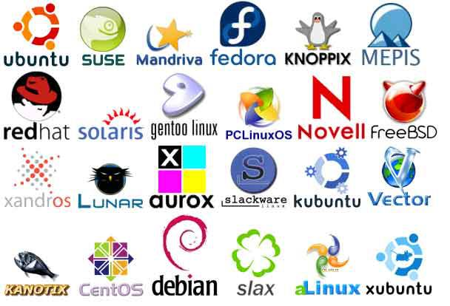
What is a distribution?

Slide 20









Linux Distribution
The most popular Linux distributions are:
Ubuntu Linux
Linux Mint
Elementary
Zorin
Fedora
OpenSUSE
And don’t think the server has been left behind. For this arena, you can turn to:
Red Hat Enterprise Linux
SUSE Enterprise Linux
Ubuntu Server
CentOS
Debian

Slide 21
Linux vs. UNIX
UNIX OS | Linux
Unix is developed by AT&T Developers. Later UNIX divided by two different flavor one is System-V and another one is BSD version. | Linux is a Kernel. Developed by Linus Torvalds. Linux OS development by an active Linux Community worldwide.
The Source Code of Unix is not available for the general public. | The Source Code of Linux is freely available to its Users.
UNIX is mainly used in Server Systems, Mainframes and Super Computers. | Linux is mainly used in Desktops, Low end Server, Mobile Phones, etc.
Most of the UNIX are hardware dependent. | Linux OS not hardware dependent.
UNIX primarily uses Command Line Interface. No multimedia. | Linux used as both Graphical and Command Line Interface.
UNIX not user friendly. To operate UNIX you must require previous system administration knowledge. | Linux is user friendly. We can start Linux from beginning level.
Different Versions of Unix are: AIX, HP-UX, Solaris, UNIX BSD, Iris, etc | Different Versions of Linux are: Ubuntu, Debian, OpenSuse, Redhat, Fedora, etc

Slide 22
Linux vs. Windows
Linux | Windows OS
It is an open source software everything is free | It is a proprietary software everything need to buy
Developed by Linus Torvalds | Developed by Microsoft corporation
Linux combined with the GNU system to produce a complete free OS. | Windows OS in neither open source nor free OS and is the property of Microsoft.
High Security | Less Security compare to Linux
Low Hardware Requirements | High end hardware requirements
Virus Frees
Tiny & Lighter OS
Mainly used for Server, Supercomputer | It is user friendly (Desktop/Laptop User)
Linux File System: ext3/ext4/XFS | Windows File System: NTFS, FAT32
Popular Linux Distributions are: RedHat, Ubuntu, Debian, Mint, Fedora | Windows OS: Windows XP, Windows Server 2008/2012/2016, Windows 7/8/10

Slide 23
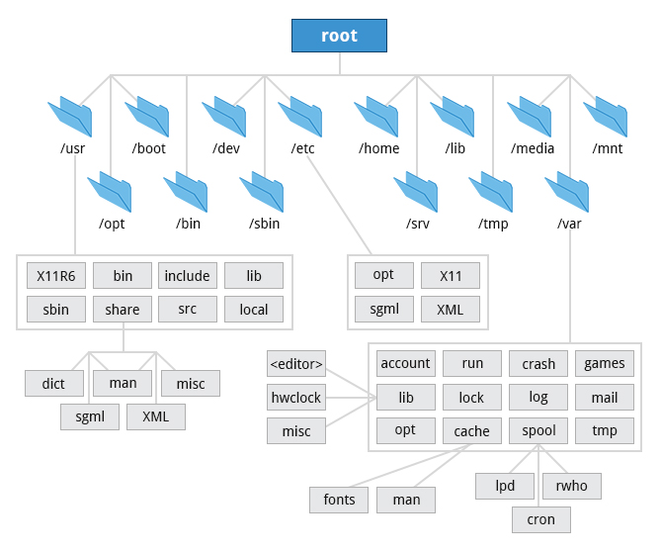
Linux File System

Slide 24

Thank you
Have a nice time with Linux!

